Slide 1
Differential Input Single Ended Output Folded Cascode Design
Dec 01, 2020
Prepared by: Muhammad Arsalan Athar
MERL

Slide 2
Outline
Schematic
Design Approach
Schematic entry (Ngspice)
Layout
Results with Summary Table

Slide 3
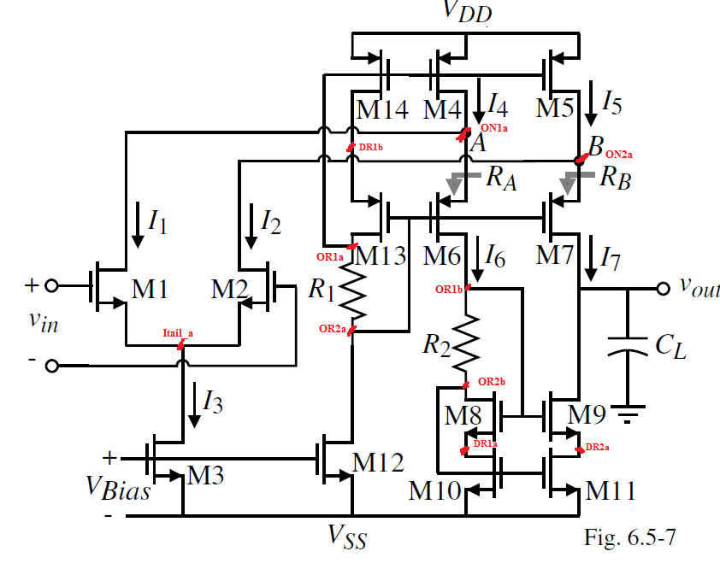
Schematic

Slide 4
Design Approach

Slide 5
Design Approach (Continued)
In order to get slew Rate = 10V/us, we design the circuit in 150nm pdk for 1.8V thick oxide Transistors using 150nm Skywater 150nm PDK at
V_{DD} =1.8V, V_{SS}= 0V
I₁=I₂= 50uA
I₃= 100uA
I₄=I₅=I₁₃=I₁₄=I₁₂= 120uA
I₆=I₇=I₈=I₉=I₁₀=I₁₁= 70uA
Vin = 10mVpk-pk

Slide 6
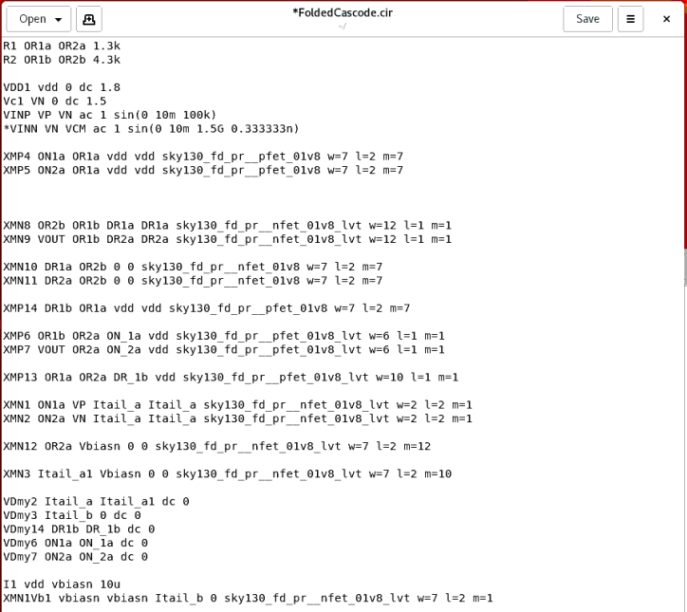
Schematic Entry (Ngspice)

Slide 7
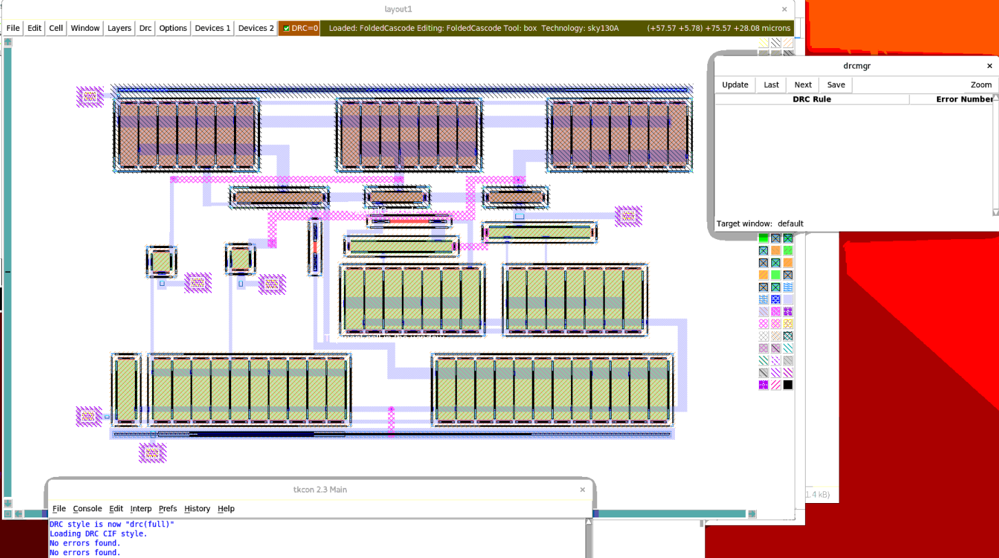
Layout in Magic

Slide 8
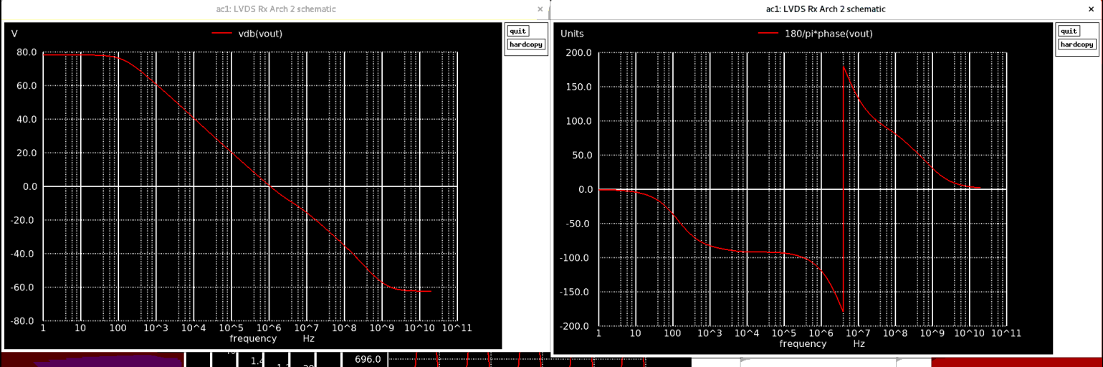
Results Summary Table

Slide 9
Results Summary Table
References | This Work
skywater Tech. [nm] | 150
Supply [V] | 1.8
Gain [dB] | 79
Phase [degrees] | 60
Bandwidth [MHz] | 1-5
Current Consumption [uA] | Less than 500

Slide 10
Thank You …

